Slide 1
S0. Economics of Environment : the Age of Constraints
Xavier Timbeau
xavier.timbeau@sciencespo.fr
Anissa Saumtally
anissa.saumtally@sciencespo.fr

Slide 2
Scope and aims of the course
What is going on?
Human activity and ecosystems, how it interacts ? What problem are caused ?
Is it population ? Development ? Waste and wrong incentives ?
How reliable ? to what extent ? What can we do (setting goals) ?
What are the social consequences ?
How can we assess the problem ?
Measurement & models
What are the solutions ?
Are capitalism&individualism compatible with sustainability and carrying capacity constraints ?
Should we aim for sobriety through autonomy and degrowth ?
Are there some cases where human activity was made sustainable? How?
Why isn't going to solve by itself ? What is different today and what are the present-day challenges?
What is currently done? Are COPs going to save it?
Aim #1: acknowledge the extent of the limits to human operation on earth
Anticipate and understand the disaster to come
Aim #2: imagine what should be done to cope with the constraints
Imagine the world of tomorrow, technically, politically and socially

Slide 4
Who are you?
From where ?
Your background
Your formation so far
To where ?
What do you intend to do after the master
What do you expect form the course ?
feedback most welcome !

Slide 5
« Anyone who believes that exponential growth
can go on forever in a finite world is either a madman or an economist»
(Kenneth Boulding, US Congress adress, 1973)
« If you want to save the planet,
don’t hug a tree, hug an economist »
(unknown , probably not assumed)
Xavier Timbeau, xavier.timbeau@sciencespo.fr
Anissa Saumtally, anissa.saumtally@sciencespo.fr
Nathalie Ovide nathalie.ovide@sciencespo.fr
Google drive EoE 2023-24 (check you have access)

Slide 6
Evaluation
40% Multiple Choice Questionnaire
3 sessions, during course : 14/02; 21/03; 11/04
approx. 30 minutes, online, instant mark, based on previous lessons
In case of absence, please report to Anissa or me
60% Individual or group work
Book review
Paper on a book, a report, a bunch of papers
About 20k char. [10, 30k], try to be exhaustive& clear & pedagogic
Or debate club
5 sessions will be partly devoted do debate
One subject, 2/3 in favor, 2/3 against as animators
Participation of the class
Online polls in the class
For the animators (2 groups of 3 for each 3 debates)
a brief report plus a presentation post mortem for the evaluation (last week of semester)
Theme 1 nuclear; theme 2 growth versus degrowth (or autonomy versus labor division); theme 3 food sobriety; theme 4 high tech versus low tech, or geoengineering ; theme 5 inequality
Or research work (group of 4 max ; could be individual) :
Case studies : propose and we try to work out a way. It is strongly sugested that you conduct the evaluation of a public policy
brief report plus a presentation for the evaluation (last week of semester)

Slide 7
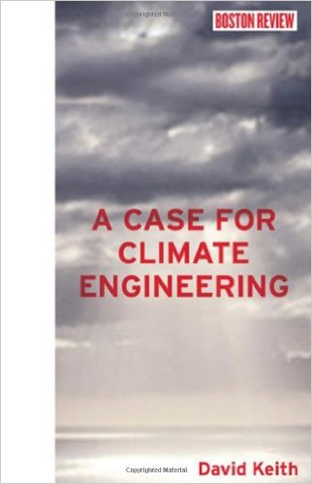
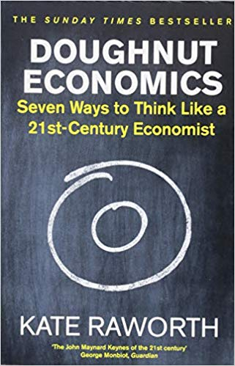
Some books you may enjoy reading
Evaluation: book review
Dissertation on a book
Reading note, 20k car (approx.), langage French or English
present main points, report on debates about the book
Hall of fame : Tim Jackson (prosperity w/o growth), Jared Diamond (Collapse), Lester Brown, Nicholas Stern, Barber, Naomi Oreske, Erik Conway, James Hansen, The story of Rachel Carlson, Hans Jonas, Singer and so on
Due by the end of the semester (tbc, end of april 2024)
In English or French, at your convenience

Slide 8
Outline of the course
30/1~6/2 session 1 Malthus&Co, Consequences of limits
6/2 session 2 The case of Air Pollution
13/2 session 3 Carrying capacity and drivers for human impact/debate club #1 Nuclear energy versus RNW
27/2 Quizz 1/session 4 IPCC&Earth Summit, superficial ecology versus deep ecology
5/3 session 5 A crash course on Climate Change (CCCC1) mechanisms and scientific analysis/debate club #2 degrowth&co
12/3 session 6 CCCC2 Civilization and climate
19/3 session 7 CCCC3 IPCC scenarios and consequences& carbon budget/debate club #3 food sobriety
26/3 Quizz 2/session 8&9 CCCC5 Who Where and Why : emissions of GHG understood
2/4 session 8&9 CCCC5 Who Where and Why : emissions of GHG understood/debate club #4 low versus high tech
9/4 session 10 Inequality and pollution
16/4 session 11 Policy Tools/debate club #5 inequality
23/4 Master Quizz/session 11 : Lessons from the Montreal Protocol or Why and How are we going to Stop Climate Change
This outline is provisional and subject to change. Course is based on interaction and participation.

Slide 10
S0. Economics of Environnement
Xavier Timbeau
xavier.timbeau@sciencespo.fr

Slide 16
The Debates
Five questions that will be debated in this course.
Let’s see where everyone stands !

